Slide 1
Machine Learning Fundamentals
Connor Craft
29/04/2019

Slide 2
Contents
Exploring the data
Can you predict how much someone will write in the essays by their age?
Sorting the Data
Visualising the Data
Producing the Models
Improving the Models
Conclusion
Can the body type of an individual be predicted using attributes typically associated with health?
Sorting the Data
Visualising the Data
Producing the Model
Making Predictions
Conclusion
Conclusions

Slide 3
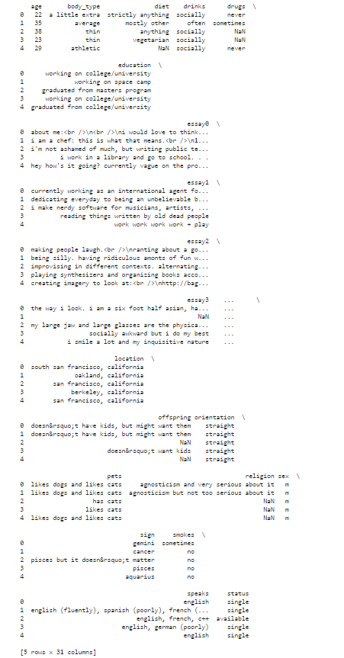
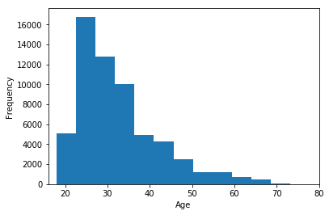
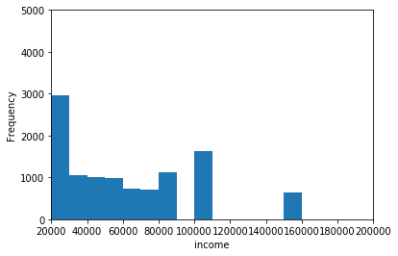
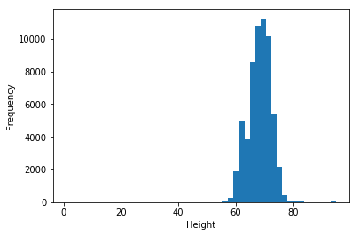
Exploring the Data
Figure 1
The first step of any data analysis is to take a look at the data you have to work with.
After saving the data set in a Pandas Data Frame, a sample of the first 5 entries of the data set were visualised using the .head() function. (Figure 1)
This showed that most of the data appeared to be a mix of multiple choice options and continuous written answers.
Figures 2, 3 and 4 show the amount of members with certain age, income and height respectively.
After producing the graphs below the age of the members was used to formulate the first question, as although it had a strong positive skew, the data appeared well distributed.
Further data visualisation was carried out during the production of the machines.
Figure 2
Figure 3
Figure 4

Slide 4
Can you predict how much someone will write in the essays by their age?

Slide 5
Sorting the Data
It was decided that a linear regression machine should be used to solve this question.
The first step in producing this machine was to sort the data.
Initially the essay lengths were recorded and separated into a different data frame (words) than the rest of the data.
The new data frame was then used to calculate the total length of all the essays combined, producing a new column in the data frame. This column was produced by simply summing all the other values in the row.

Slide 6
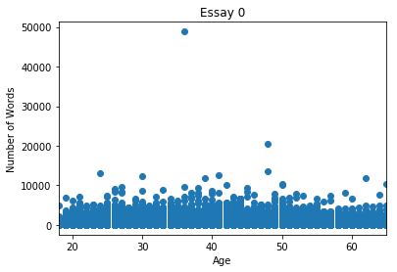
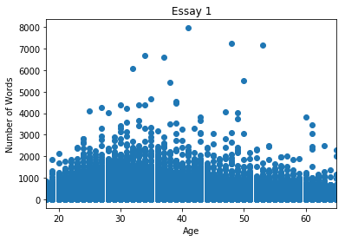
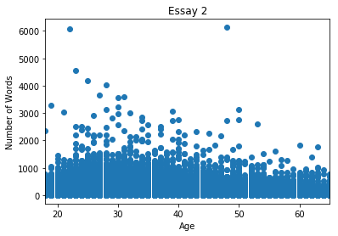
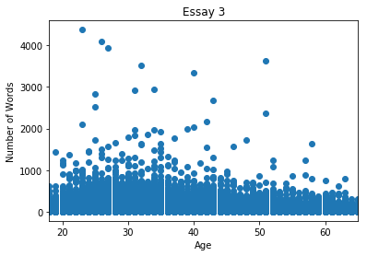
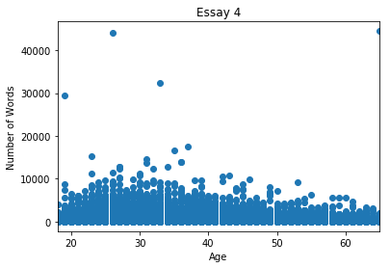
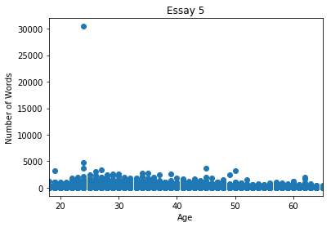
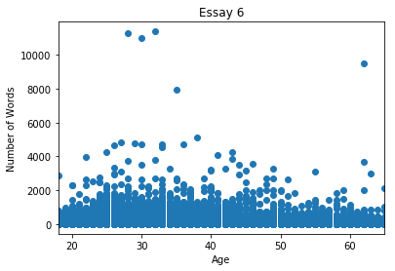
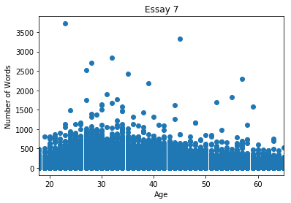
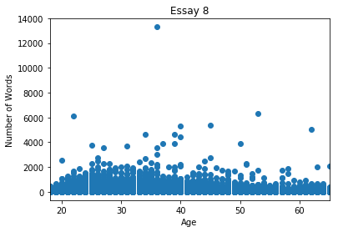
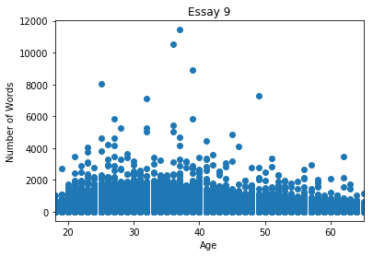
Visualising the Data
Each essay length was compared to the age of each member, which can be seen in the graphs in figure 5.
There are obviously a few outliers in each essay set, with some being significantly larger than the rest of the set.
Unlike the data for age, there is no obvious skew for each essay length, suggesting all ages write a similar amount.
All the graphs were limited in the x-axis length as there are only a handful of data points over 70 and they are over 100, so missing them out is negligible.
Figure 5

Slide 7
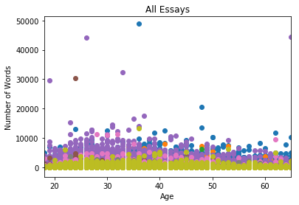
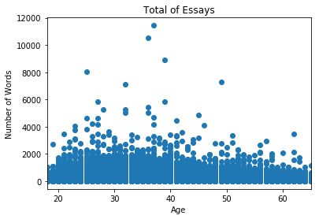
Visualising the Data (Continued)
Figure 6
All essays were then plotted on one graph, as shown in figure 6.
This showed that the outliers did not always occur in the same age range, and relative to other essay answers, some outliers no longer appeared as much of an outlier.
Then the total length of all combined essays was visualised in a similar scatter plot, shown in figure 7.
Again this showed no obvious skew, except that there were significantly entries at the younger ages, which was expected with the age range skew.
Figure 7

Slide 8
Producing the Models
The first step for producing the models was to separate the data into a training set and a testing set.
This was completed using the “train_test_split” function, imported from sklearn.
Using this function the data was split into 80% testing and 20% training randomly, with X values being associated with age and Y values being associated with the essay lengths.
The training data was then fitted using sklearn’s “LinearRegression” function.
Before any predictions were made, the “coef_” function was used to see which of the essays were correlated to the age of the member.
The table shows the results of this.
While most essays did not have a strong correlation at all with the age of them member, essay 0 and the total word count did appear to have at least a small connection to the age of the member.
Essay Number | Correlation Coefficient
0 | 12.05255823
1 | 1.89916247
2 | 0.80727095
3 | 0.11984021
4 | -0.80045338
5 | 0.51903455
6 | 0.59946918
7 | 0.28736005
8 | 0.22328402
9 | 1.47118679
Total | 17.17871306

Slide 9
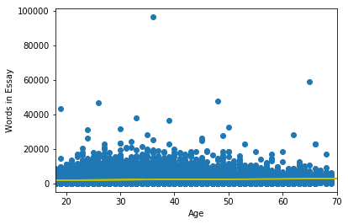
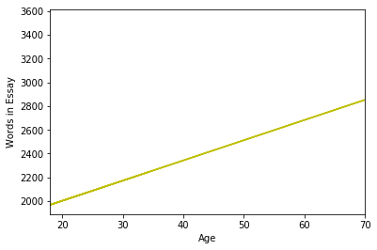
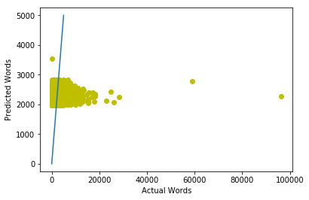
Producing the Models (Continued)
The first linear regression model produced was using the total length of essays to predict ages, as the total length had the strongest correlation.
The data was split randomly using 80% to train the machine and 20% to test the machine.
This yielded a very low score, 0.004721148697827915, when using the linear regression score function suggesting the models would get just under 5 in 1000 correct.
Figure 8 shows the linear regressor’s fitted line on the complete data set. It appears that a large amount of the data is well above the line. The line of best fit plotted by itself can be seen in figure 9. Figure 9 shows that the linear regressor does estimate that older members write more in total than younger members by a difference of about 900 between ages 18 and 70.
Figure 10 compares the predicted length of the essays vs the actual length of the essays, with a line of gradient 1. If the predictions are accurate then all the points should appear on the line. However, the data shows that it is mostly off of the line, hence the low score for this model.
Figure 8
Figure 9
Figure 10

Slide 10
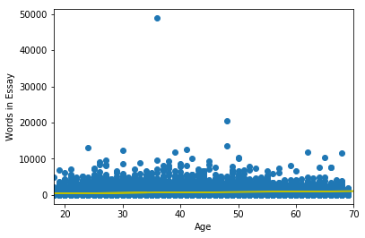
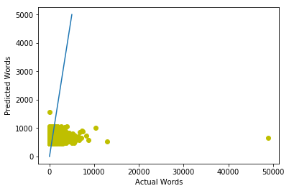
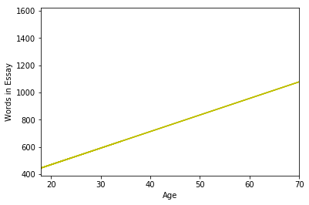
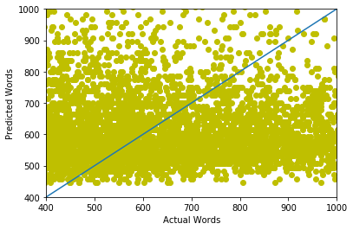
Producing the Models (Continued)
The next model produced was using essay0’s length, the second highest coefficient, and the age of the member. This linear regressor was produced using the same data splitting method, but produced a significantly higher score: 0.01743883734784338, suggesting it is correct 17 times in every thousand.
Figure 11 shows the linear regressor’s prediction vs the data for the entire dataset. When compared with figure 8 it is clear that the data is a lot more concentrated around a certain length. This less varied data might be why the score is higher for this linear regressor than the previous one.
Figure 12 shows the regressor’s prediction plotted by itself. Again it has predicted that older people tend to write more, but this time the difference is only about 600 between 18 and 60.
Finally, figure 13 shows predicted words vs actual words, with a line of gradient 1. If the regressor was very accurate then all the points would be close/on the line, however this figure shows that this is not the case. Figure 14 is part of the same graph in figure 13 except it is zoomed in to see the data clearer. Figure 14 shows that the data does not follow the line very much at all, and may be too dispersed for a linear regressor to work accurately.
Figure 11
Figure 12
Figure 13
Figure 14

Slide 11
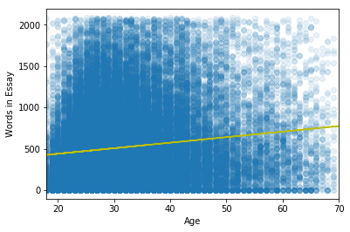
Improving the Model
Finally, in an effort to improve the accuracy of the linear regressor, the machine using essay0’s data was rerun but this time with outliers removed. All data points outside of 2 standard deviations from the average were removed and then the data split was carried out the same as before.
This yielded a worse result when using the accuracy score than previously found: 0.016255866566465504.
Figure 15 shows this data set and the machine’s linear regression prediction. For this graph a different alpha was used to get a better idea of the data’s spread but shows that the line is far from covering them all.
The prediction again suggests that older people write more than younger people, as expected from positive correlation, but the correlation is not strong enough for this method to be accurate.
Figure 15

Slide 12
Conclusion
The results of trying to predict amount written by age show that it is not possible by linear regression. The data does not have a strong enough correlation for this to work accurately, even once outliers are removed.
The linear regression machine may have worked better if all the data was normalised, so instead of the exact lengths of each essay being used, just knowing if it was relatively long may have been able to produce a more reliable result.
More variables with a more positive correlation to the age of the members would have helped the machine predict more accurately.
A version of classification could potentially work for the data set, for example a support vector machine, however unless more variables are added, it appears unlikely that any machine learning could predict this. The Support vector machine would also need to group the amount of words more generally than the linear regression machine, as it cannot predict in the same continuous fashion.

Slide 13
Can the body type of an individual be predicted using attributes typically associated with health?

Slide 14
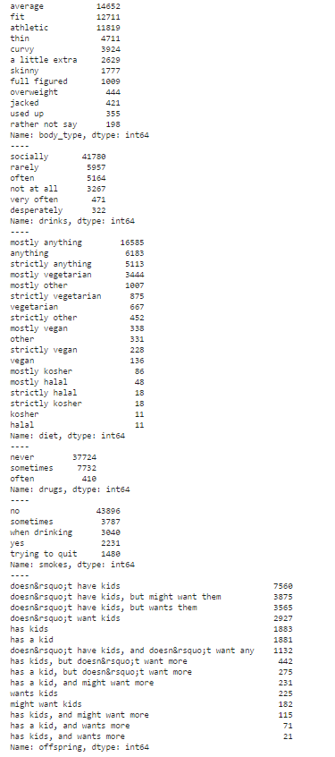
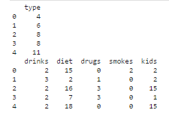
Sorting the Data
Figure 16
The first step in this process was to turn the data into numerical values so that it could be used in a classification machine learning model. The attributes chosen in order to predict body type were drinks, diet, drugs, smokes and offspring.
Using the “value_counts()” function, all the potential outcomes for each were found, which can be seen in figure 16.
The options were then turned into a numerical value, including the outcomes with no data, as these could be useful for identifying body type. (Eg. Overweight people might hide their dietary tendancies)
These were then saved to data frames, a sample of which can be seen in figure 17 where the top data frame is the body type data and the bottom is the data used to predict the body types.
Figure 17

Slide 15
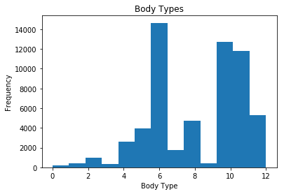
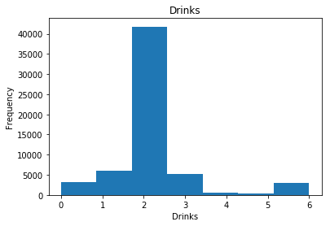
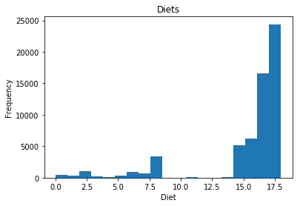
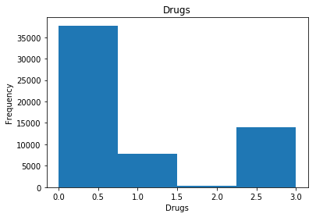
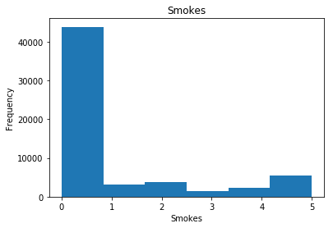
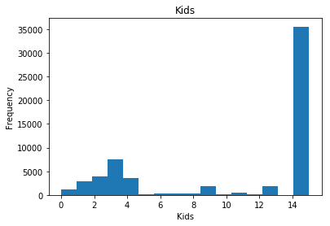
Visualising the Data
The next step to produce the classifier was to visualise the data.
Using histograms, the frequency each option was chosen by a member can be clearly seen (figure 18).
These histograms have shown that the data is not particularly well distributed between the possible options, with most of the members identifying similarly to the questions. This could cause an issue for the classifier if everyone identifies the same regardless of their body type.
Figure 18

Slide 16
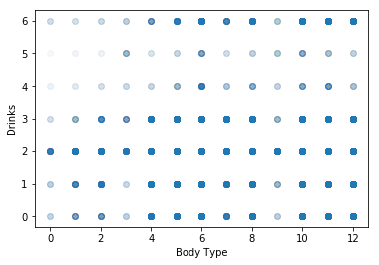
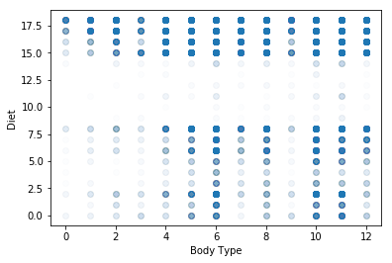
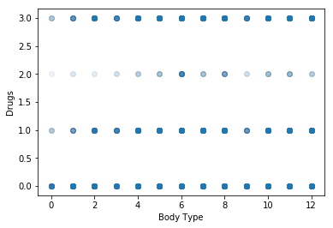
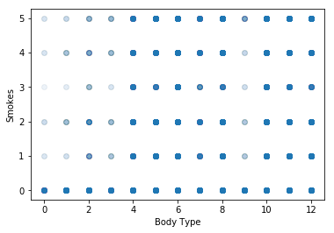
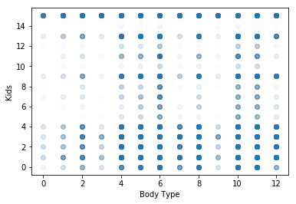
Visualising the Data (continued)
After viewing the data in figure 18, the data was compared to the body types of each member, in order to see if the data was dispersed over the variety of body types.
From this we can see that body type 6 – “Average” almost always has all possible options associated with it. This may make it difficult to distinguish from any other body type.
Body types 10 and 11 (fit and athletic) also have a similar problem to body type 6. This is understandable as these 3 body types are what 80% of members identify as, but it will make it difficult to distinguish them all from the other options.
Figure 19

Slide 17
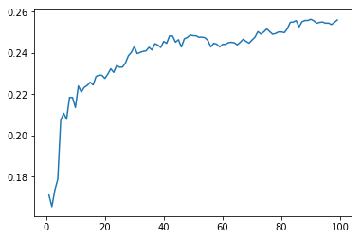
Producing the Model
The next step was to split the data into a training data set and a testing data set. This was done using the “train_test_split” function also used in the previous machine for predicting essay length.
The training data was then passed through a loop which varied the number of neighbors considered in the “KNeighborsClassifier” function from sklearn. This loop slowly increased the n_neighbors value from 1 to 100 while training the data. It scored each attempt using the “accuracy_score” function from sklearn. If the score was a new high it saved the value of n_neighbors and the accuracy score.
The looping allowed the optimal number of neighbors to be found using a simple trial and error method. Figure 20 shows how the accuracy scores varied over the loop values. The optimal value for the number of neighbors was found to be 90 using this method. N_neighbors = 90 returned an accuracy score of 0.2563803169307756. If randomly chosen the score would be 0.077. The machine’s accuracy score is about 3.5x better than random, but still not a great accuracy score, as it gets little over a quarter correct.
By manually entering in some results and using sklearn’s “.predict” function some predictions were confirmed, for example, [1,1,1,1,1] returned a value of 6, meaning rarely drinks, a diet of “other”, sometimes does drugs, smokes “when drinking” and doesn’t want kids returns a body type of “average”.
Upon further investigation, when entering a set of values all relating to having a blank value
([5,18,2,4,16]) a value of 12 is returned which is also an empty column. This could be suggesting the
classifier got this correct, as it had nothing to work from, but it also provided and idea
for further experimentation.
Figure 20
Accuracy Score
Number of Neighbors

Slide 18
Making Predictions
The classifier was then used to predict the body types of the members who had left that section of their profile blank.
First these members were separated into a different data frame using a for loop, and the classifier was retrained using only the members that had provided their body type information (using n=90).
This new classifier was then used to predict the body types of the members who had no data using the predict function.
Figure 21 shows the value counts of these predictions.
As seen in figure 21, the classifier only predicted that each member would have a body type in the four most common body type options (see figure 18).
As 80% of the members fall within one of these 4 body types, it is a fairly safe prediction that anyone will be in one of these 4, however it is not particularly accurate when it comes to other body types.
Figure 21
Predicted Body Type | Count of Prediction
6 – Average | 2370
10 – Fit | 1951
11 - Athletic | 956
8 – Thin | 19

Slide 19
Conclusion
This classifier did appear to predict body types using the known health data for members. However, with a score of just over 0.25, it is not very accurate.
The classifier appears to only choose the 4 most common body types, which account for 80% of the data. While this method does produce some correct predictions, it is not very good for the less common body types.
¾ of the most common body types are fairly similar (thin, athletic and fit), so one method of potentially increasing accuracy would be to combine body types under different catagories, eg. Fit, average and unfit. However this would leave the data very grouped around the “fit” cataegory.
The number one way of improving this would be to increase the spread of the body type data. If the data was evenly distributed over body types the classifier could not just pick the most common body type and would predict a wider variety of body types.
This classifier did not run particularly quickly thanks to the module which optimised the value of “n_neighbors” in the classifier. So another area to improve would be the speed of the classifier, however that should be optimised once the accuracy is optimised.
Linear regression would not work with this data set as it is not continuous or linear, instead a neural network might be successful in classifying the data correctly. However this may also fall into the same traps as this classifier, as the data points may be too similar to separate.

Slide 20
Conclusions
These machines were not particularly accurate and definitely had plenty of room for improvement. However they are good places to start to produce more accurate machines.
Can you predict how much someone will write in the essays by their age? – No, not really. The linear regression machine was not very successful, likely due to how uncorrelated the data was. This kind of machine learning is better suited to predicting a future outcome of highly correlated data, instead of this situation, data with little correlation.
Can the body type of an individual be predicted using attributes typically associated with health? – Yes, but not very accurately. The classifier machine was a bit more successful than the linear regression machine but still had a low accuracy score. This machine took a long time to run due to the optimisation process, which itself needs to be optimised for efficiency. The inaccuracies in this machine were largely due to data, where 80% of the entries were in 3 of the 12 possible options. Although the machine was significantly better than random selection.
To improve these machines, more data points should be used to provide more distinctive points to learn from. The main problem with both is that too many of the data points had overlapping entries, eg. Too many 18 year olds wrote the same amount as 40 year olds or too many people said they had an “average” body type and there was nothing else to distinguish them by.

